Slide 1
Naïve Bayes and SVM
Noble Xavier

Slide 2
Supervised Learning
Regression
Simple Linear Regression
Multiple Linear Regression
Decision Tree
Random Forest
Polynomial Regression
KNN Regressor
Ridge and Lasso Regression
Classification
Logistic regression
k-nearest neighbour (KNN)
Naive Bayes (Classifier)
Support vector machines
Decision Tree
Random Forest

Slide 3
NAÏVE BAYES

Slide 4
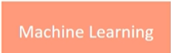
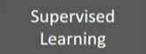
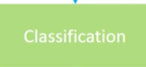

Naïve Bayes Classifier

Slide 5
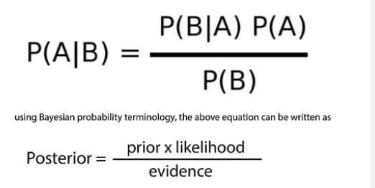
Naïve Bayes Classifier
Naive Bayes is a statistical classification technique based on Bayes Theorem. It is one of the simplest supervised learning algorithms.
Naive Bayes classifier is the fast, accurate and reliable algorithm. Naive Bayes classifiers have high accuracy and speed on large datasets.

Slide 6
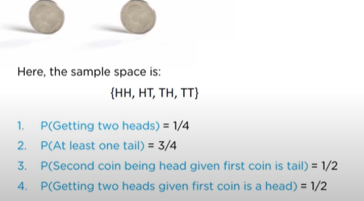
Naïve Bayes Classifier –Example
Consider the example of tossing two coins

Slide 7
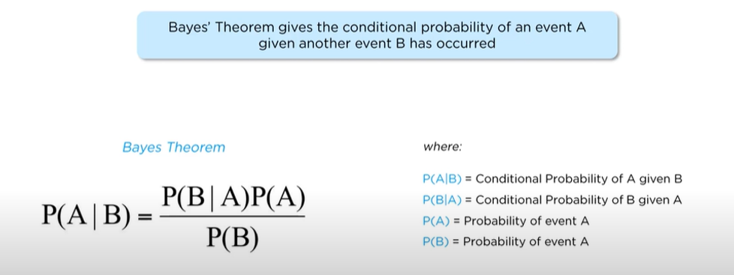
Bayes Theorem

Slide 8
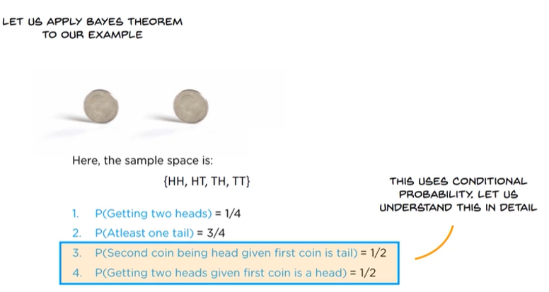
Bayes Theorem

Slide 9
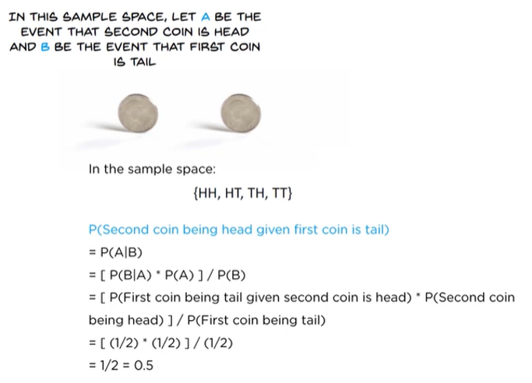
Bayes Theorem

Slide 10

Naïve Bayes Classifier –Used in

Slide 11
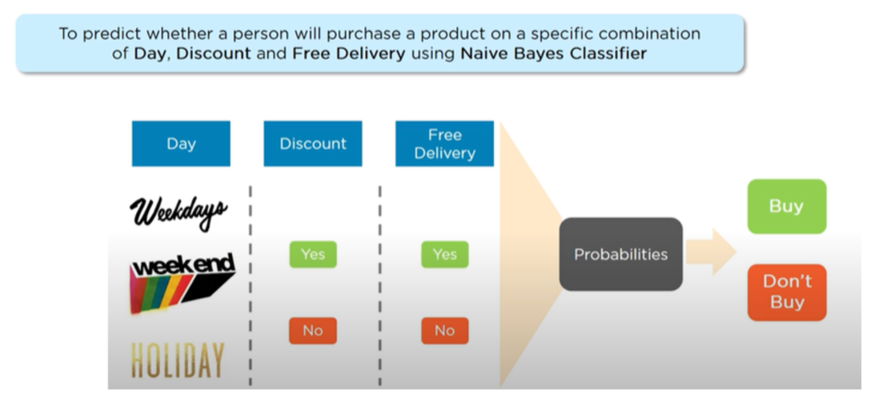
Shopping Demo

Slide 12
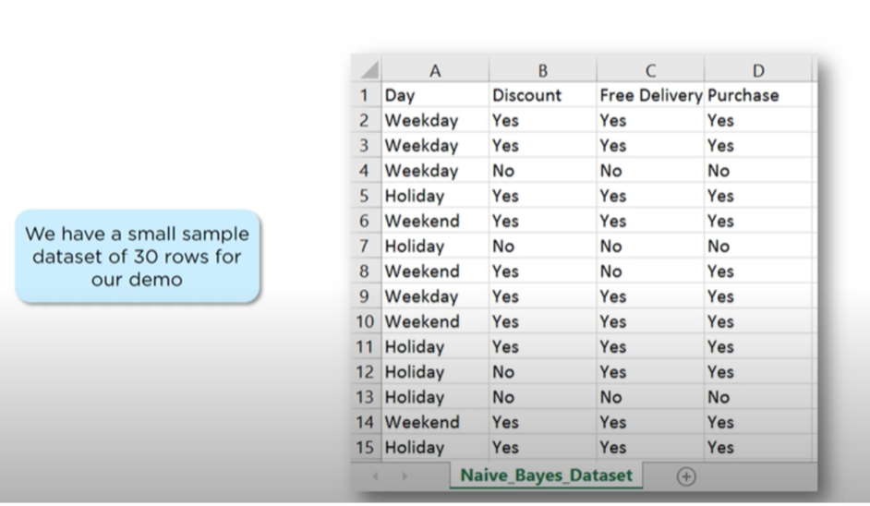
Shopping Demo- Data Set

Slide 13
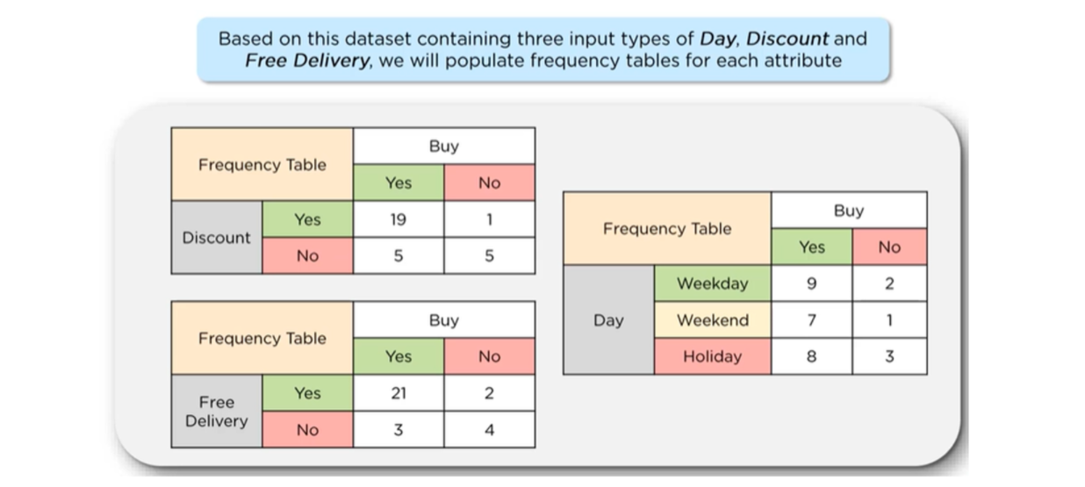
Shopping Demo-Frequency Table

Slide 14
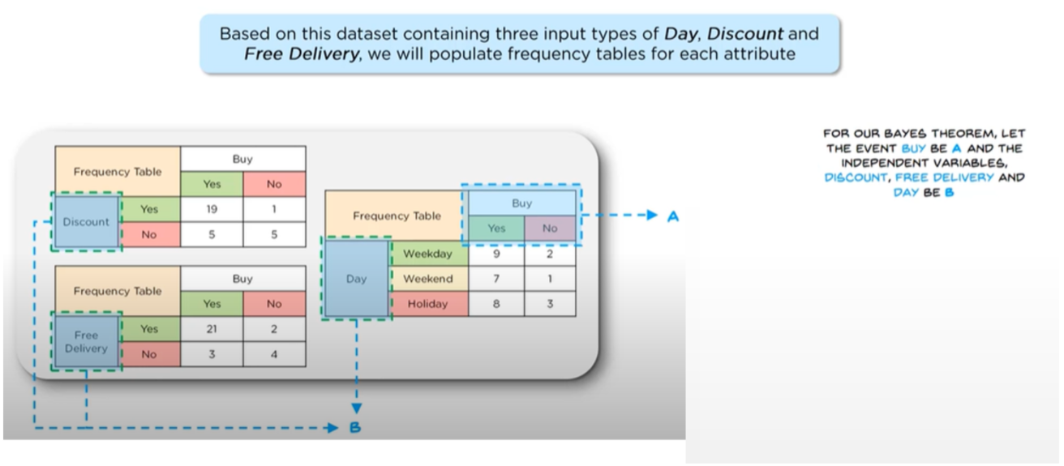
Shopping Demo-Frequency Table

Slide 15
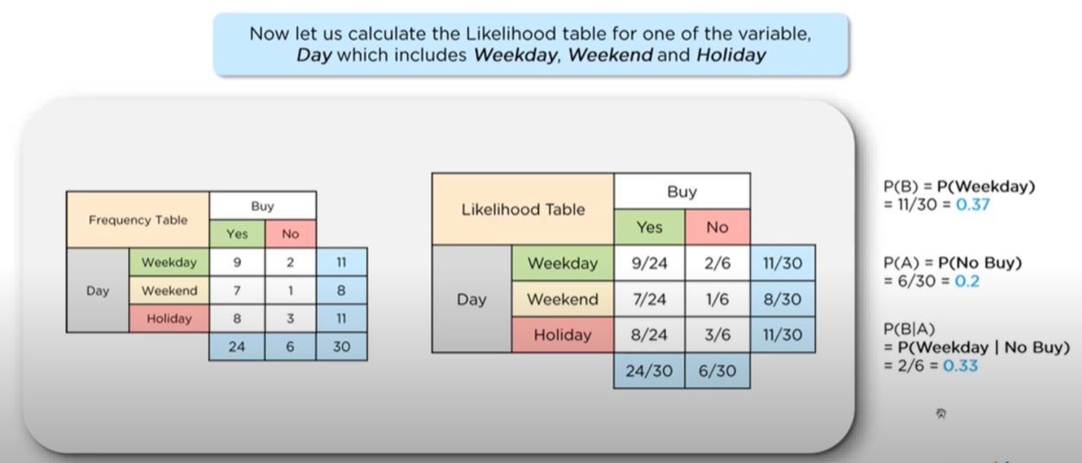
Shopping Demo-Likelihood Table

Slide 16
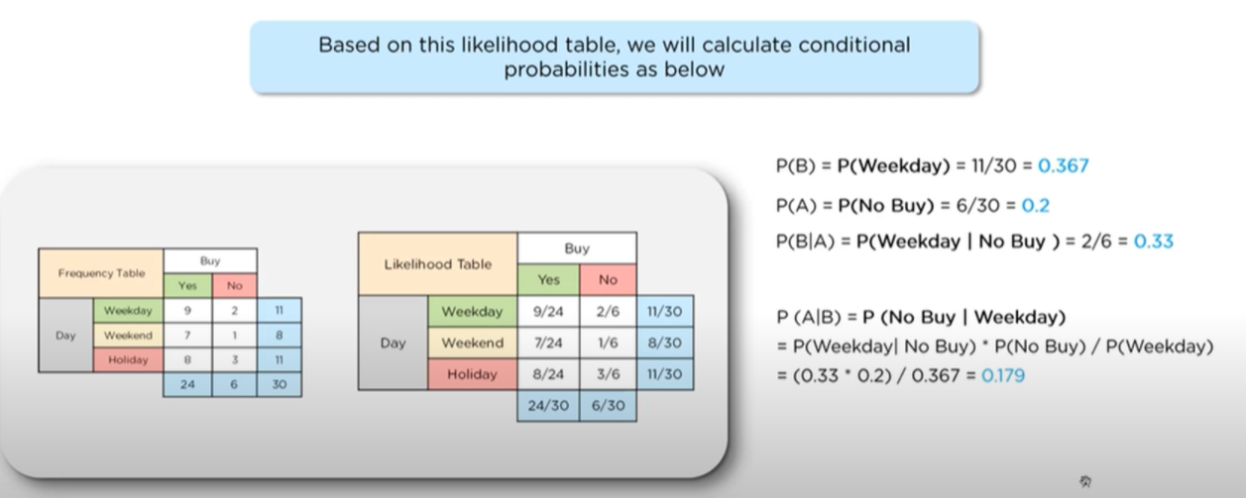
Shopping Demo-Likelihood Table

Slide 17
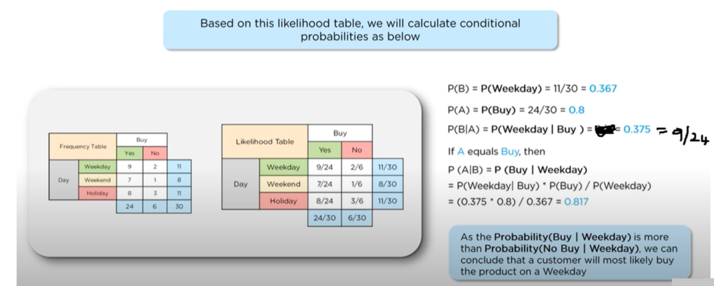
Shopping Demo-Likelihood Table

Slide 18
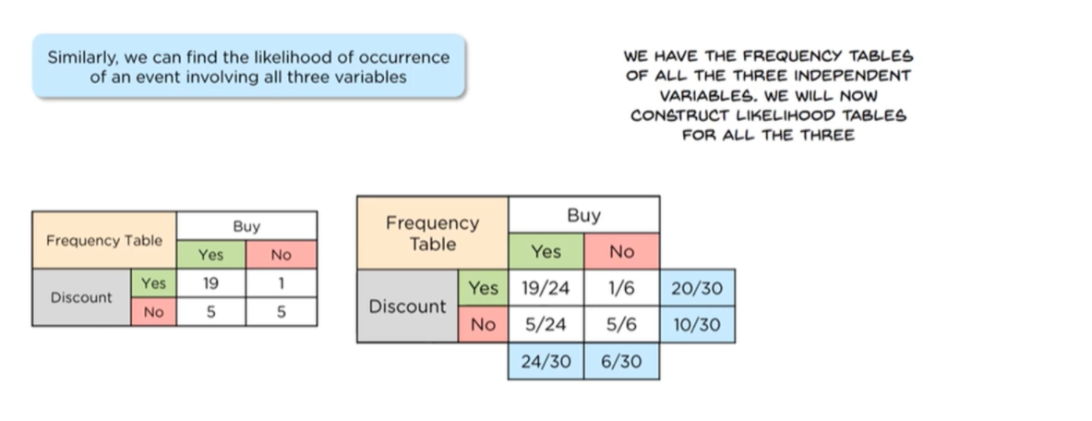
Shopping Demo-Naïve Bayes Classifier

Slide 19
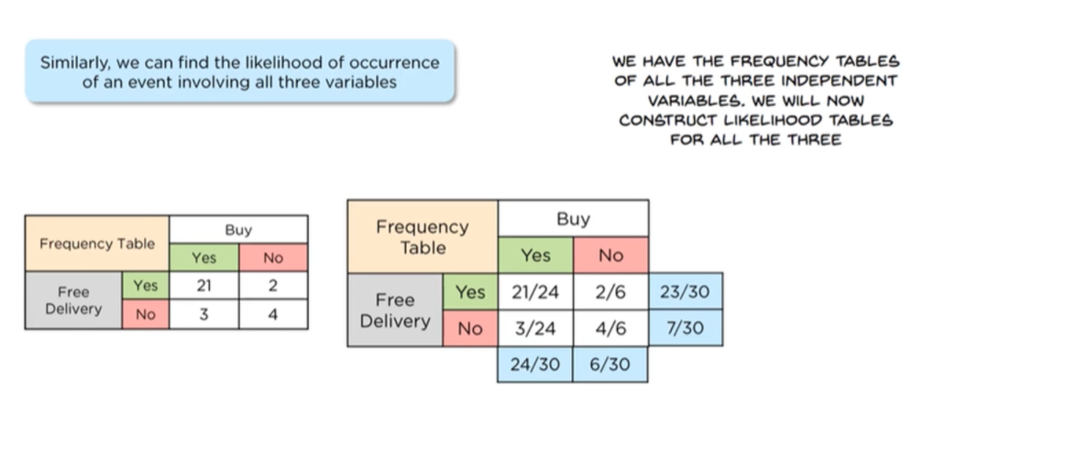
Shopping Demo-Naïve Bayes Classifier

Slide 20
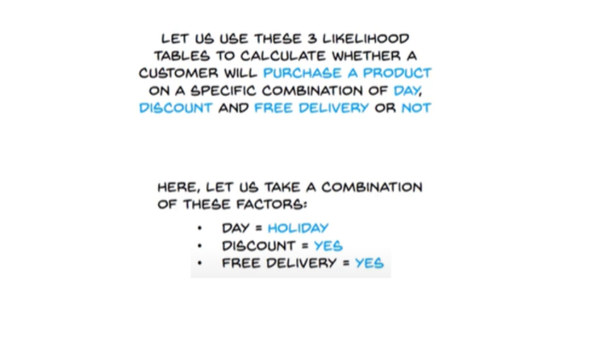
Shopping Demo-Naïve Bayes Classifier

Slide 21
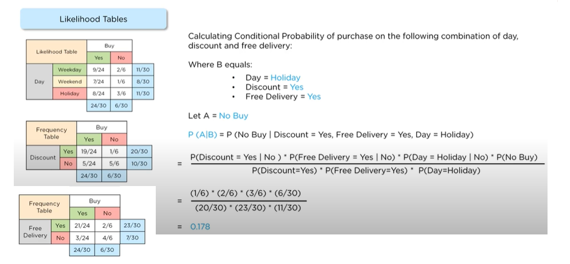
Shopping Demo-No Purchase

Slide 22
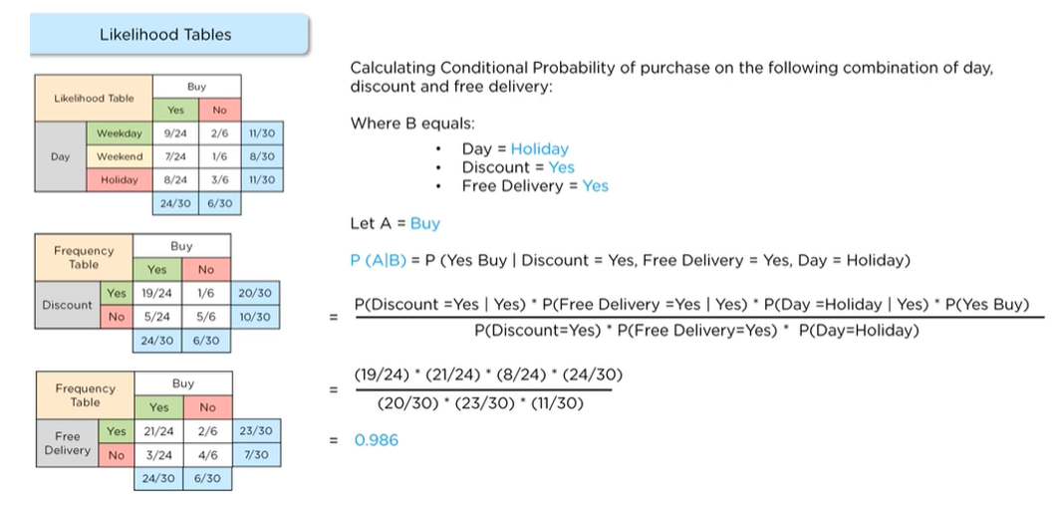
Shopping Demo-Purchase

Slide 23
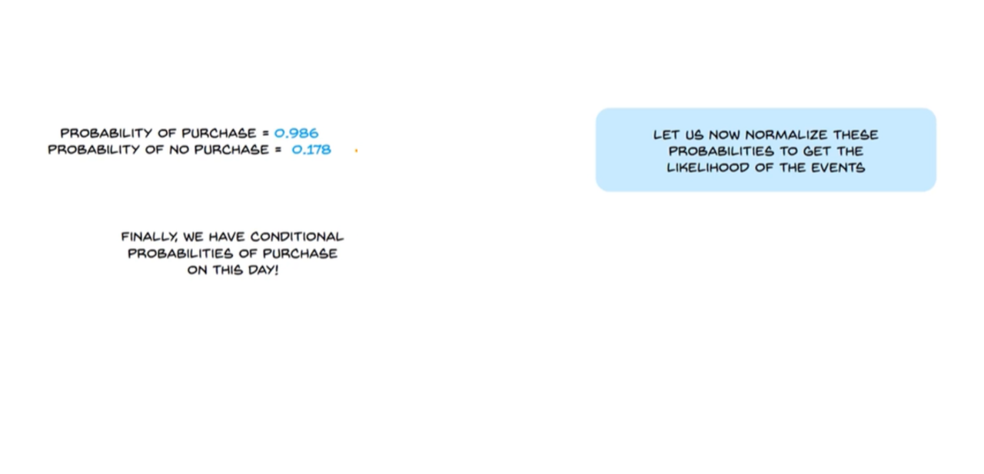
Shopping Demo-Naïve Bayes Classifier

Slide 24
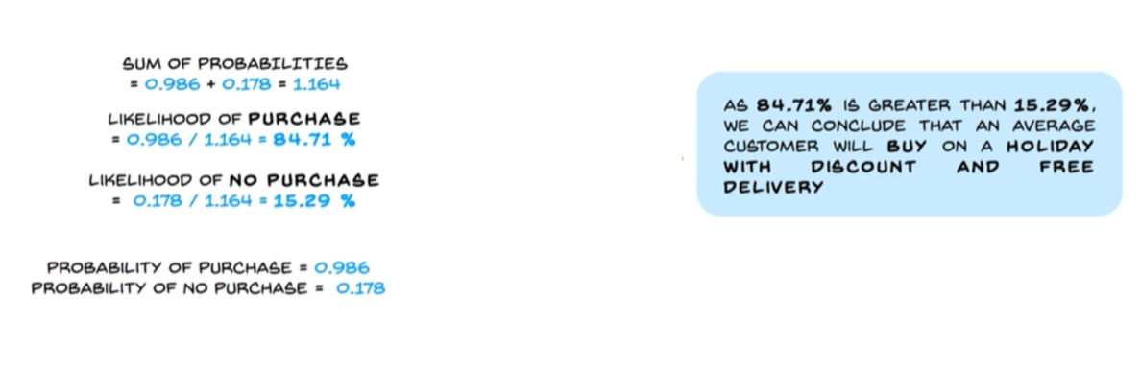
Shopping Demo-Result

Slide 25
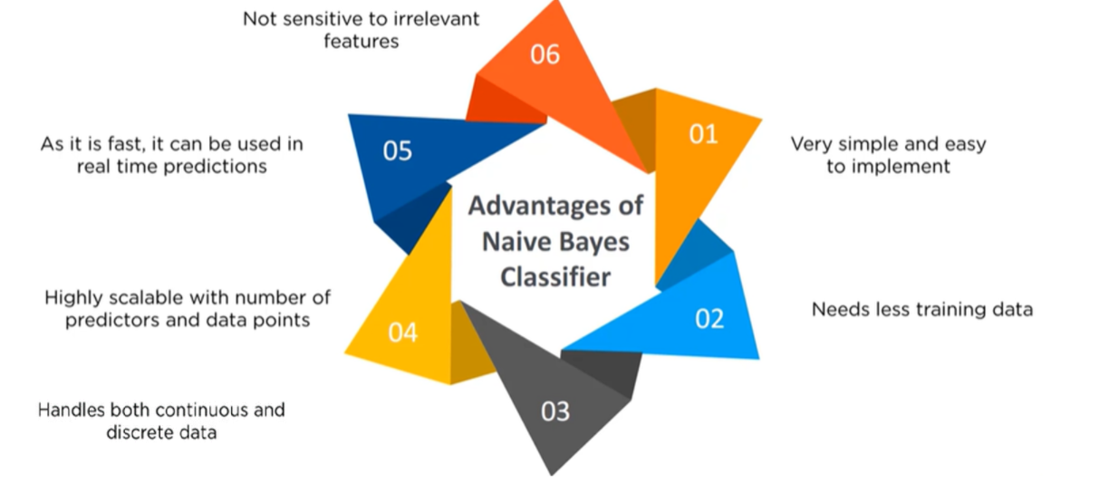
Advantages of Naïve Bayce Classifier

Slide 26
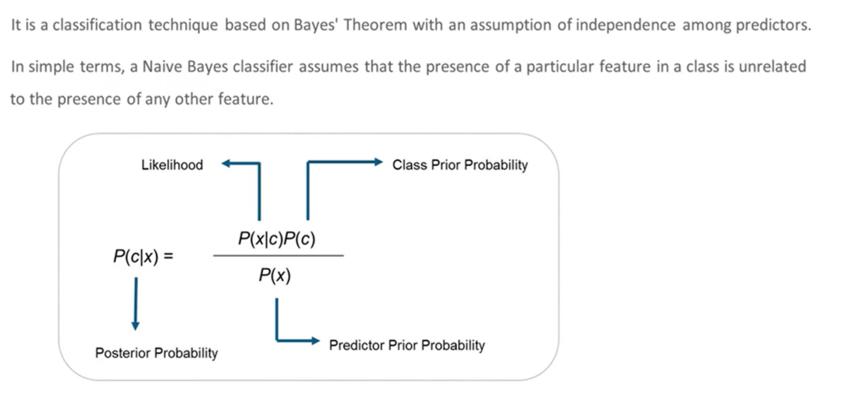
Naïve Bayce Classifier

Slide 27
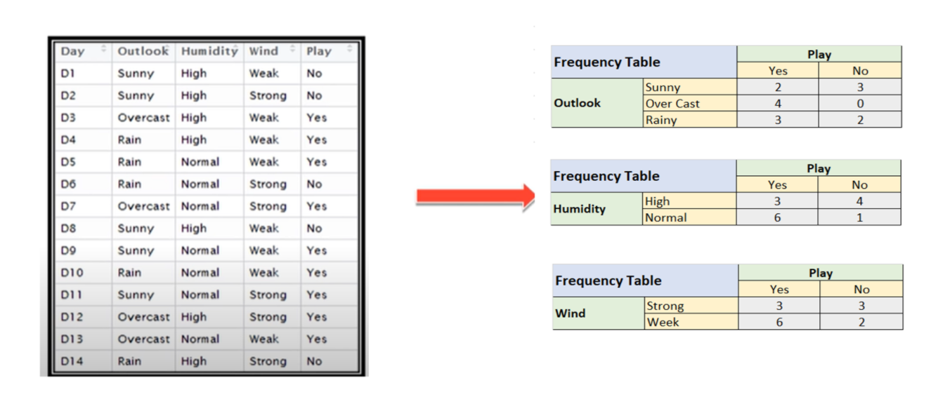
Classification Steps

Slide 28
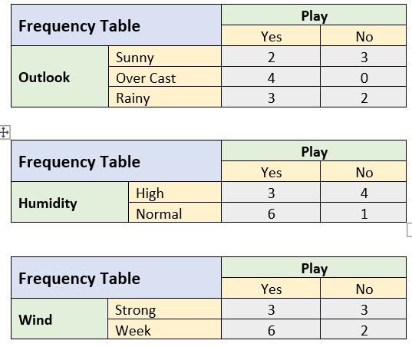
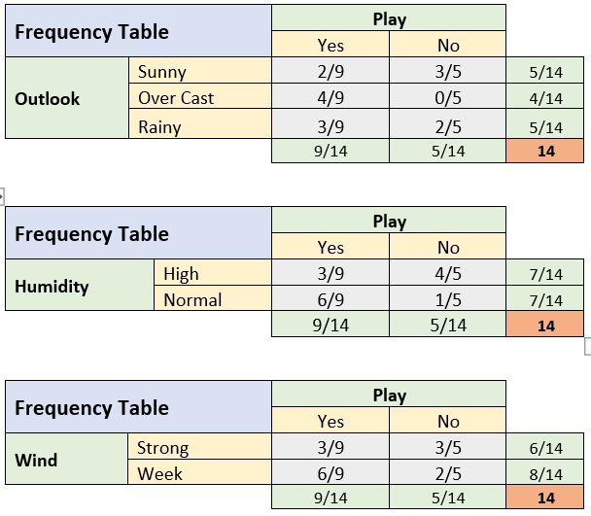
Frequency Tables and Likelihood Tables

Slide 29
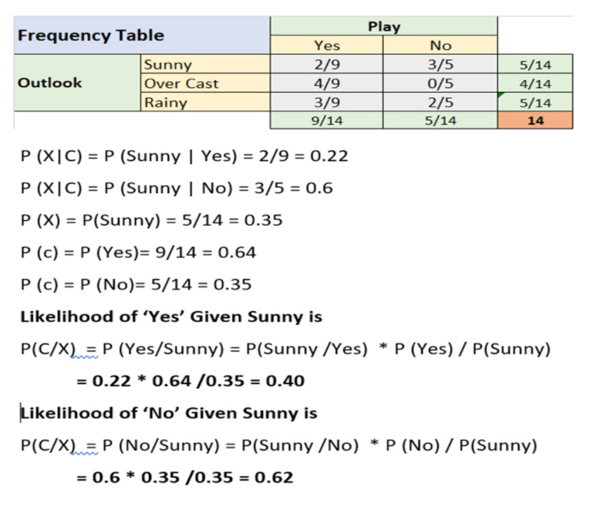
Likelihood Tables

Slide 30
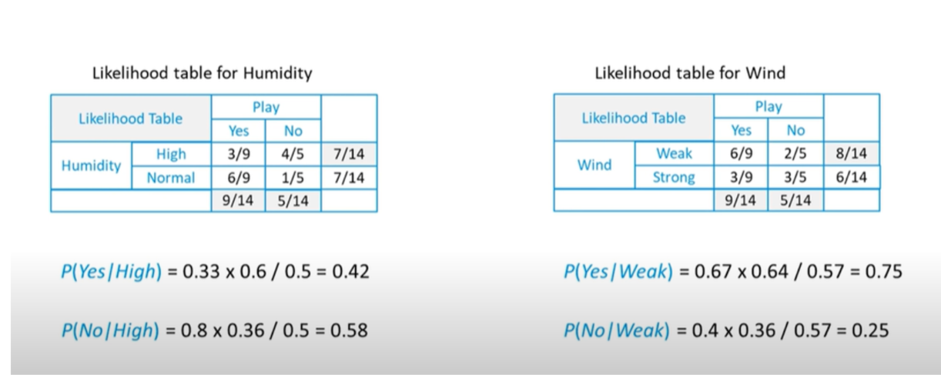
Likelihood Tables

Slide 31
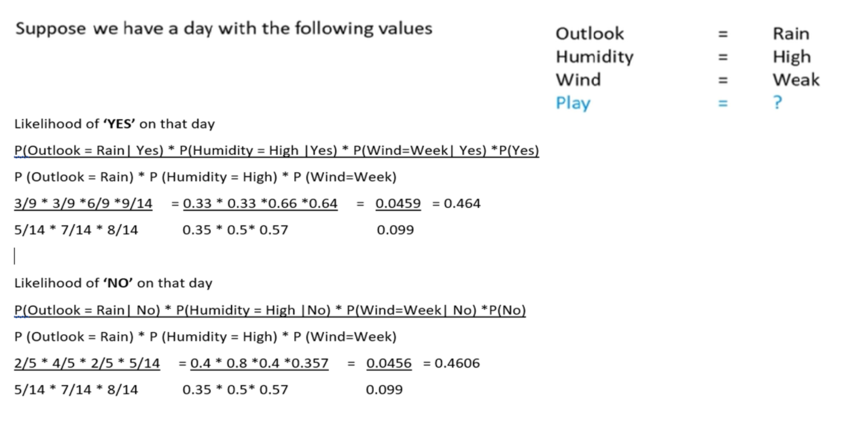
Classification Steps

Slide 32
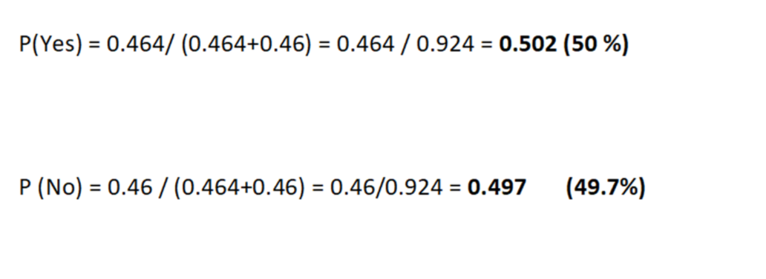
Classification Steps

Slide 33
Types Of Naïve Bayes
Gaussian Naive Bayes
Multinomial Naive Bayes
Complement Naive Bayes
Bernoulli Naive Bayes
Categorical Naive Bayes

Slide 34
Types Of Naïve Bayes
Gaussian Naive Bayes
Used for continuous data, assuming a Gaussian distribution.
It is based on a continuous distribution characterised by mean and variance. If some variables do not have a normal distribution, they might need to be transformed into features with a normal distribution
Multinomial Naive Bayes
used where the data is multinomial distributed.
Used for discrete data, especially word counts in text classification. It assumes a feature vector where each element represents the number of times it appears.
This classifier is commonly used in natural language processing tasks like sentiment analysis and spam filtering.

Slide 35
Types Of Naïve Bayes
Complement Naïve Bayes
Complement Naive Bayes is particularly suited to work with imbalanced datasets.
In complement Naive Bayes, instead of calculating the probability of an item belonging to a certain class, we calculate the probability of the item belonging to all the classes.
Bernoulli Naive Bayes
This Naive Bayes Classifier is used when there is a boolean type of dependent or target variable present in the dataset.
Used for binary or boolean features, where the attributes have a value of yes or no, useful or not, granted or rejected.

Slide 36
Types Of Naïve Bayes
Categorical Naive Bayes
The categorical Naive Bayes classifier is suitable for classification with discrete features that are categorically distributed.
The categories of each feature are drawn from a categorical distribution

Slide 37
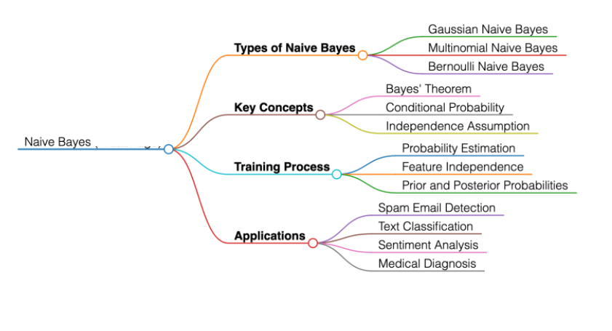
Types Of Naïve Bayes

Slide 38
SUPPORT VECTOR MACHINE

Slide 39
Support Vector Machine (SVM)
Support Vector Machine (SVM)
Support Vector Machine (SVM) is a powerful machine learning algorithm used for linear or nonlinear classification, regression, and even outlier detection tasks.
SVMs can be used for a variety of tasks, such as
text classification
image classification
spam detection
handwriting identification
gene expression analysis
face detection
anomaly detection

Slide 40
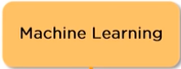
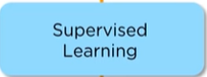
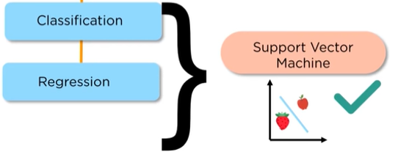
Support Vector Machine (SVM)

Slide 41
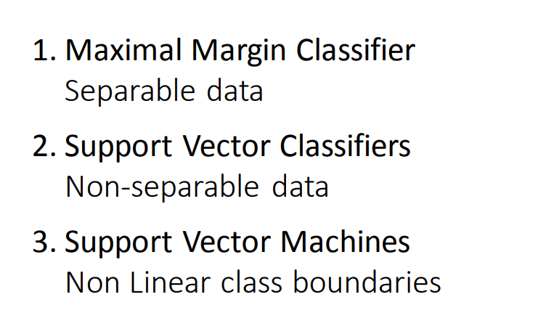

Slide 42
Hyperplane
In an N-dimensional space – The hyperplane dimension is N-1
For Example
1- D Hyperplane is a single-point
2- D Hyperplane is a line
3- D hyperplane is a flat plane

Slide 43
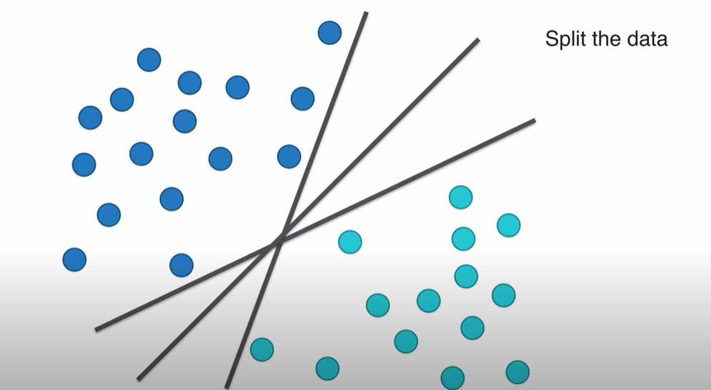

Slide 44
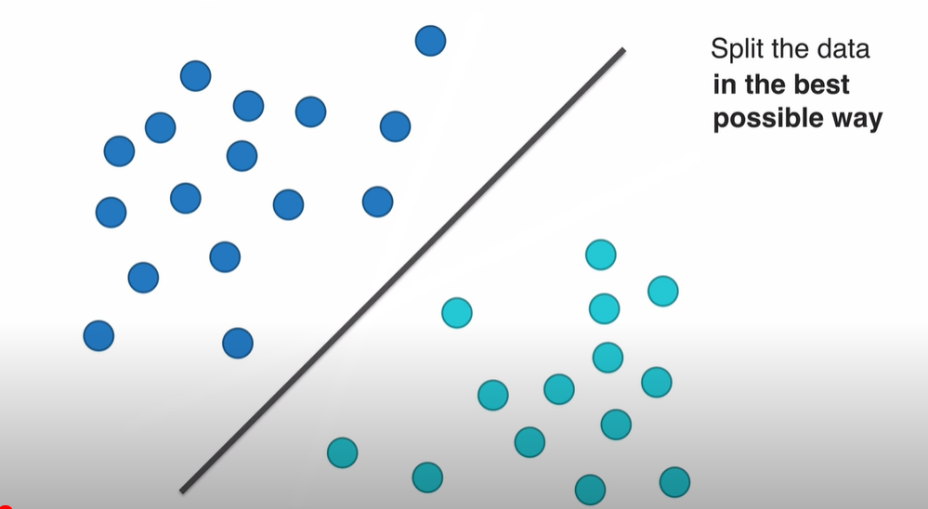

Slide 45
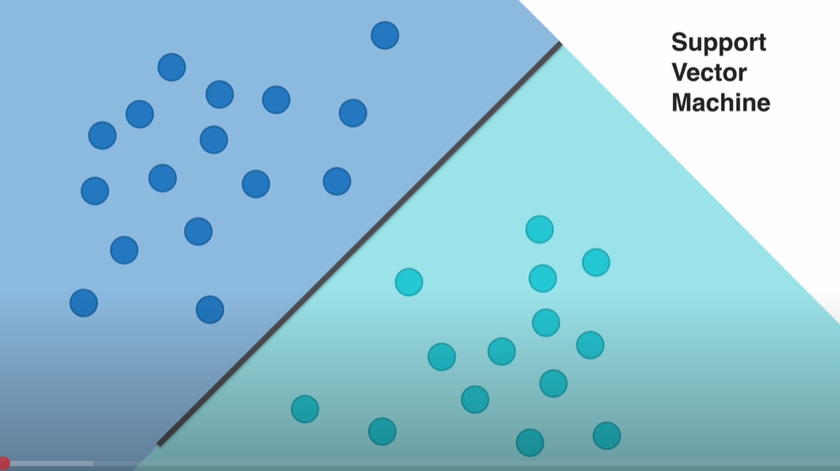

Slide 46
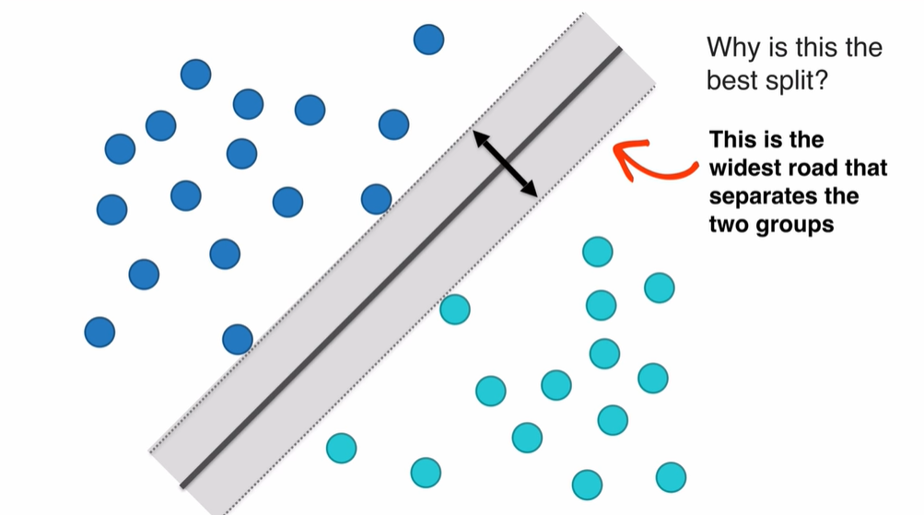

Slide 47
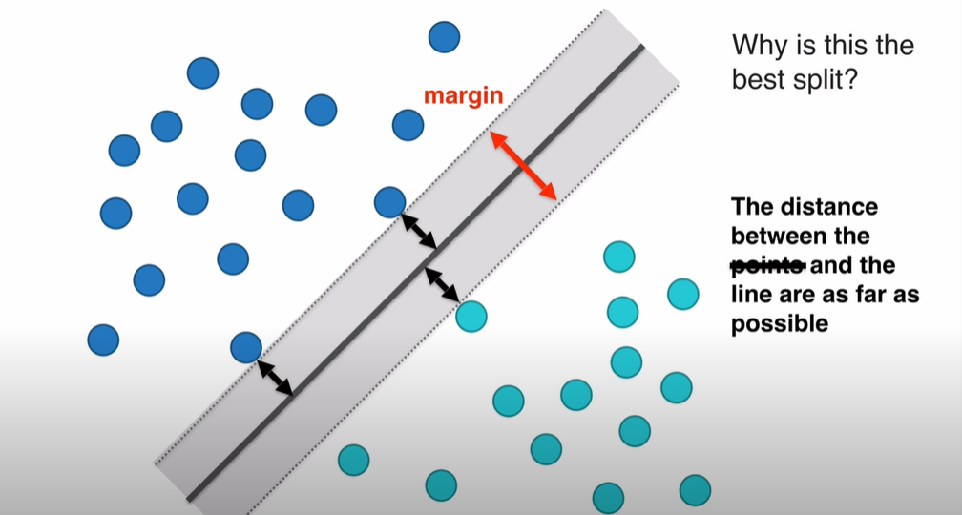

Slide 48
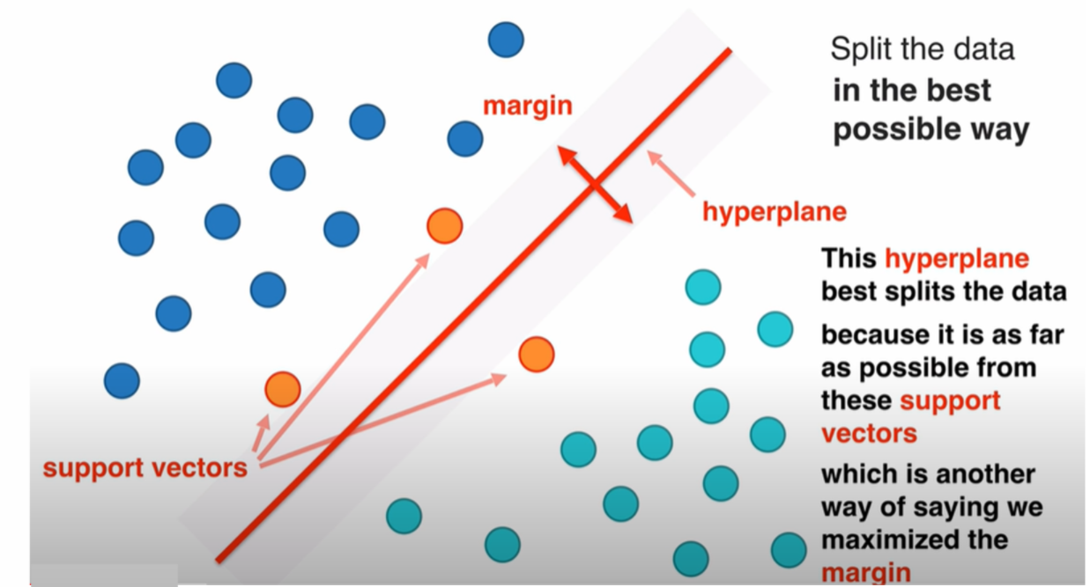

Slide 49
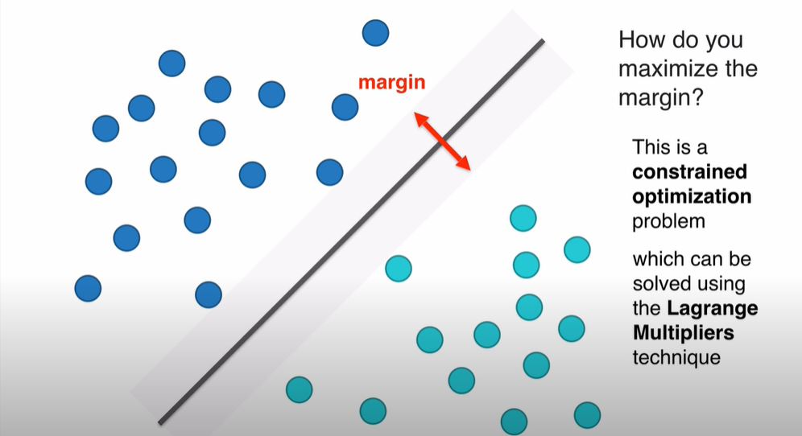

Slide 50

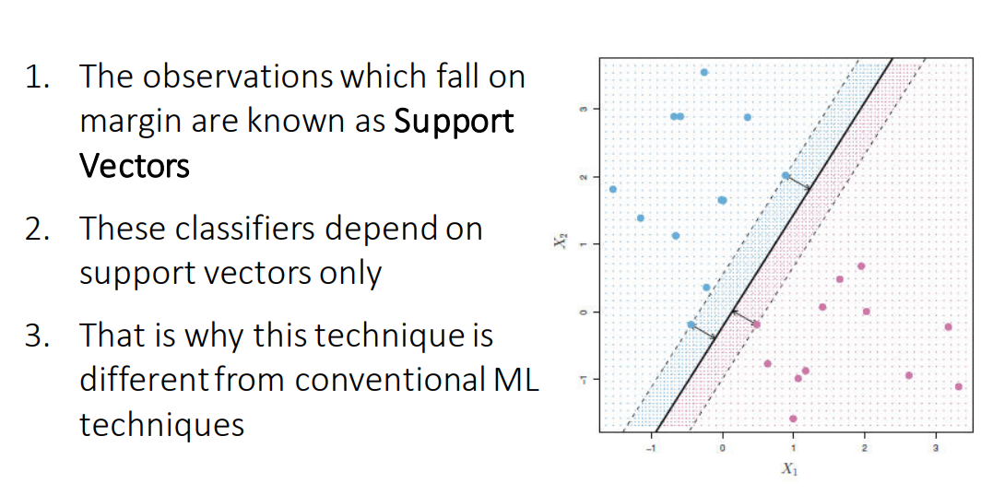
Maximal Margin Classifier

Slide 51
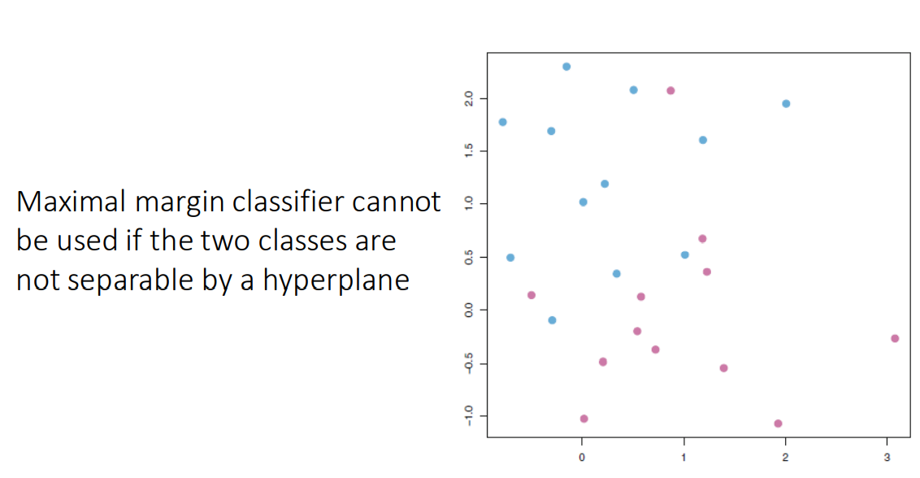
Limitation Maximal Margin Classifier

Slide 52
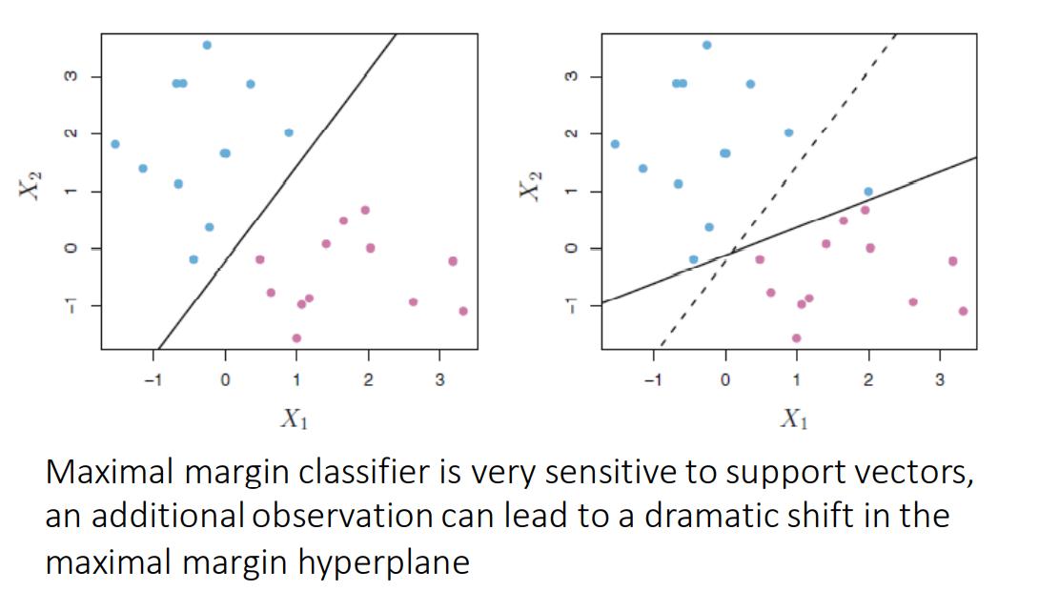
Limitation Maximal Margin Classifier

Slide 53
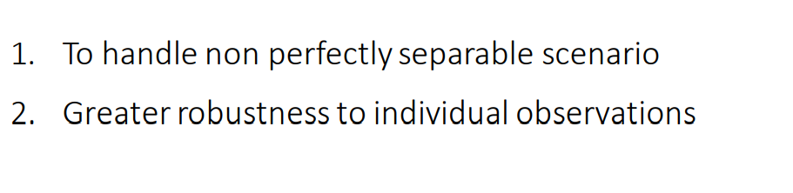
Support Vector Classifier- Why

Slide 54
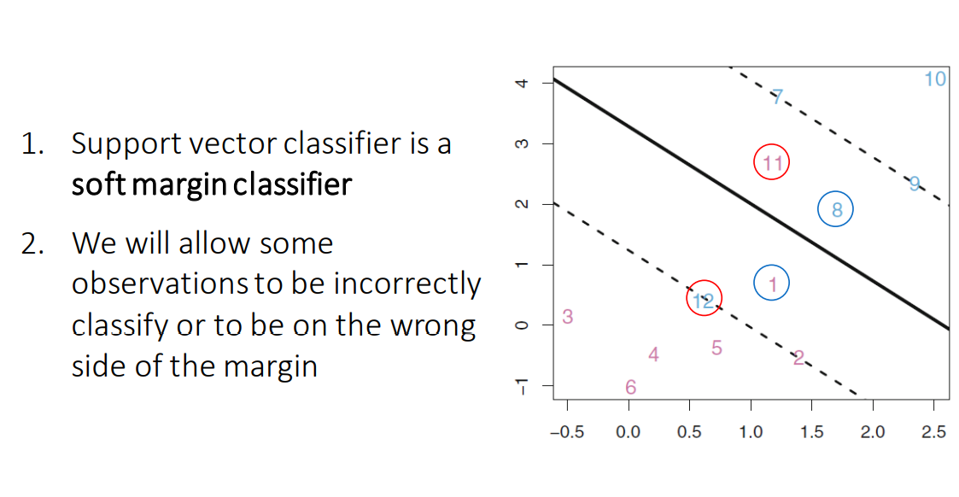
Support Vector Classifier-What

Slide 55
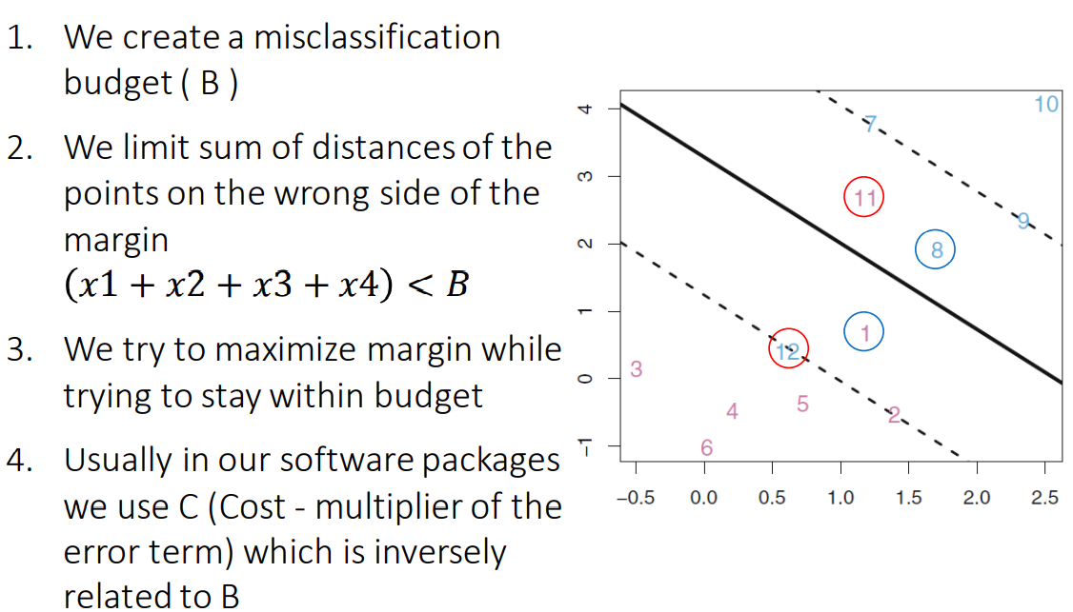
Support Vector Classifier-How

Slide 56
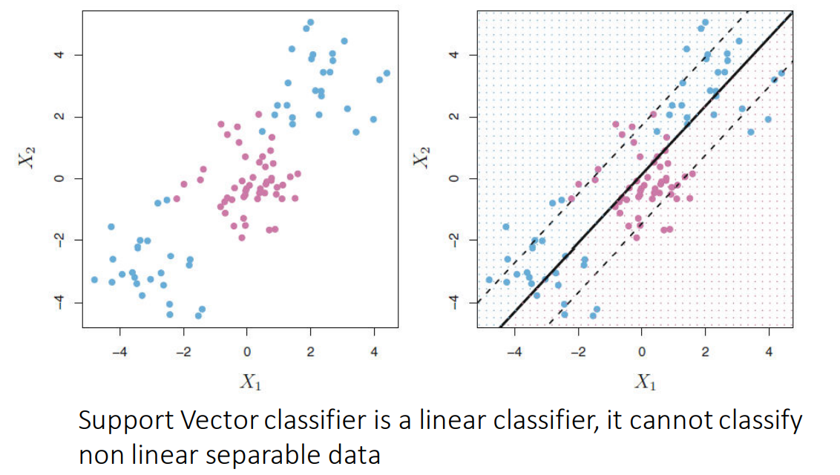
Support Vector Classifier-Limitation

Slide 57

Support Vector Machines

Slide 58

Support Vector Machines-Linear

Slide 59

Support Vector Machines-Polynomial

Slide 60

Support Vector Machines-Radial(RBF)

Slide 61

Support Vector Machine (SVM)

Slide 62

What is Support Vector Machine (SVM)

Slide 63

What is Support Vector Machine (SVM)

Slide 64

What is Support Vector Machine (SVM)

Slide 65

What is Support Vector Machine (SVM)

Slide 66

What is Support Vector Machine (SVM)

Slide 67

Support Vector Machine (SVM)

Slide 68

Support Vector Machine (SVM)

Slide 69

Advantages of Support Vector Machine (SVM)

Slide 70

Support Vector Machine (SVM) –Use Case

Slide 71

Use Case- Implementation

Slide 72

What is Support Vector Machine (SVM)

Slide 73

Hyperplane

Slide 74

Support Vector Machine (SVM)

Slide 75

Working Support Vector Machine (SVM)

Slide 76

Working Support Vector Machine (SVM)

Slide 77

Working Support Vector Machine (SVM)

Slide 78

Working Support Vector Machine (SVM)

Slide 79

Optimal Hyperplane

Slide 80

Optimal Hyperplane

Slide 81

Implementation (SVM)

Slide 82

Kernels in SVM

Slide 83

Kernels in SVM

Slide 84
Gamma in SVM
Controls the distance of influence of a single training point
Link to Demo for C Value
svmjs Support Vector Machine in Javascript: demo (stanford.edu)

Slide 85

Gamma in SVM

Slide 86

C Value
svmjs Support Vector Machine in Javascript: demo (stanford.edu)

Slide 87


Slide 88

C - Value

Slide 89

Gamma Value

Slide 90

Gamma Value

Slide 91

Hyperparameter Search

Slide 92

Grid Wise Search

Slide 93

Random Search

